Slide 1
Bridge management system (BMS)

Slide 2
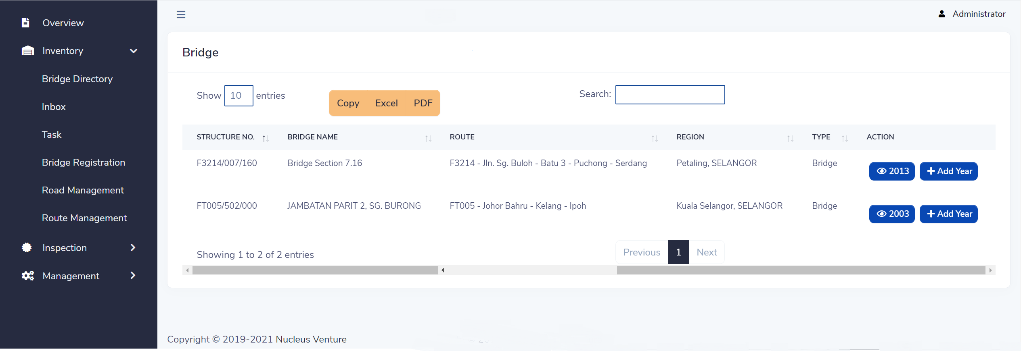
Bridge directory

Slide 3
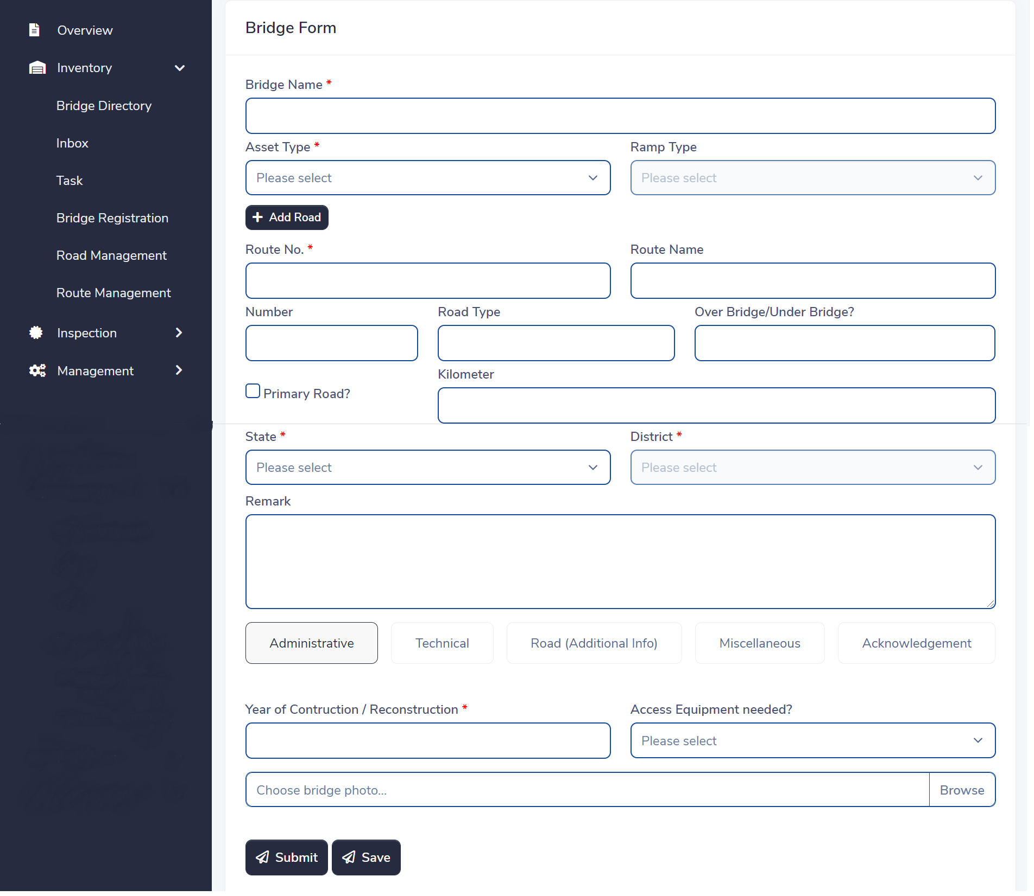
Bridge registration

Slide 4
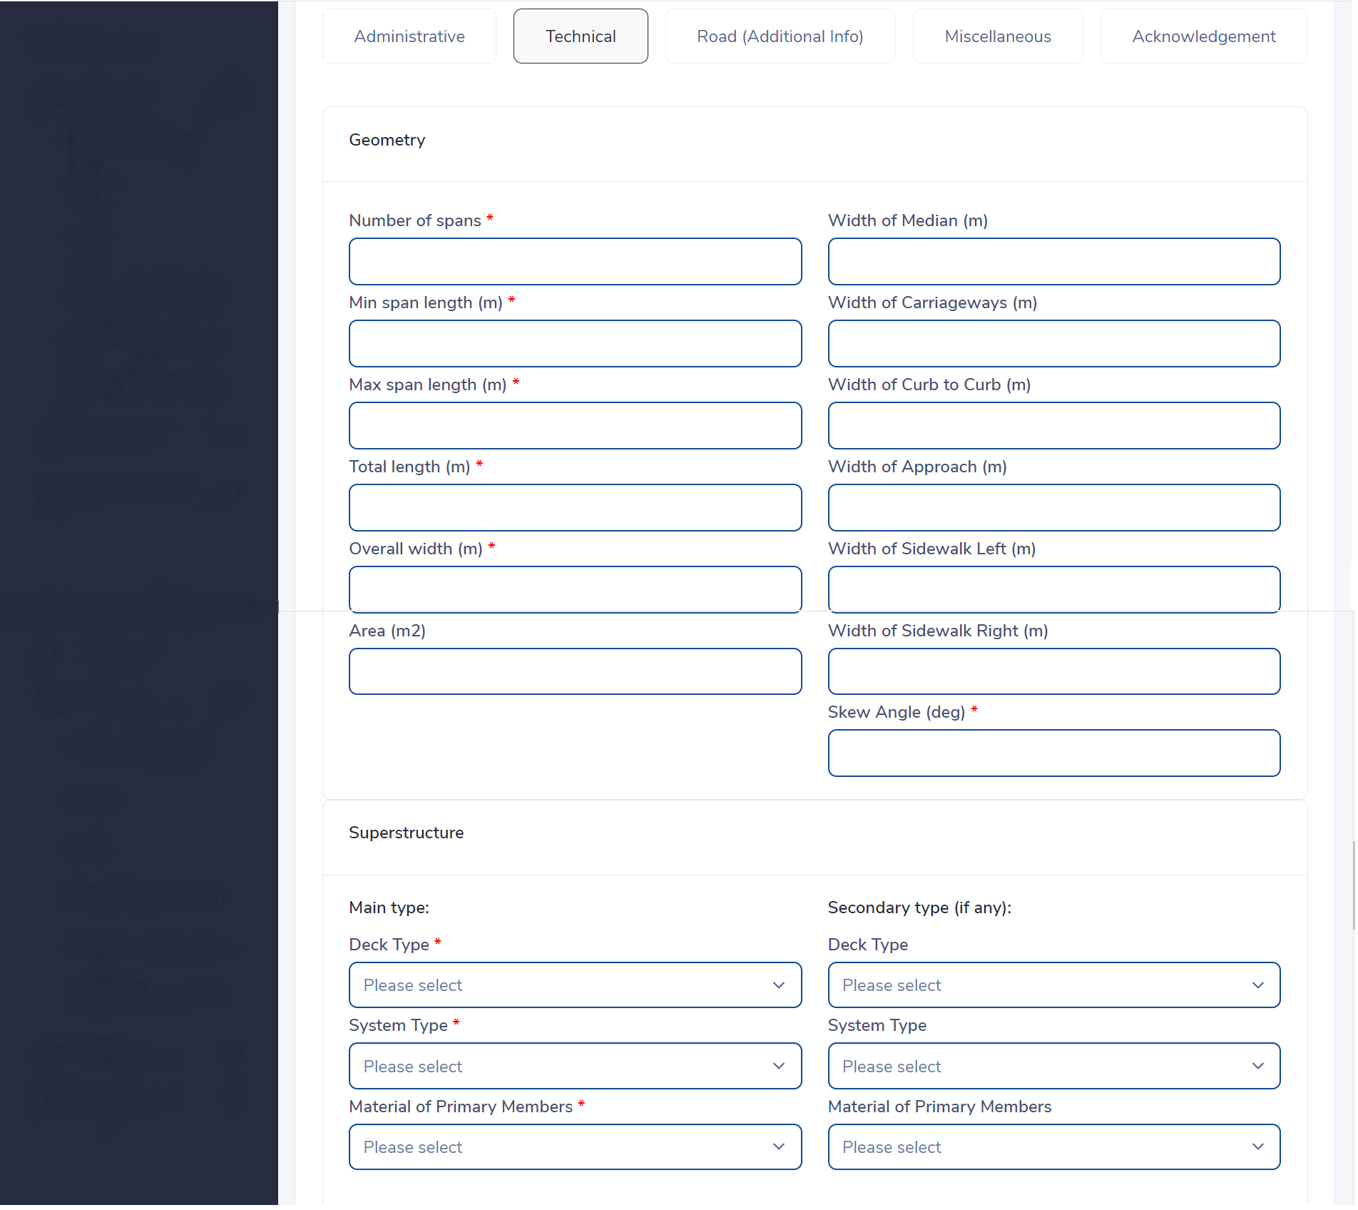
Bridge registration

Slide 5
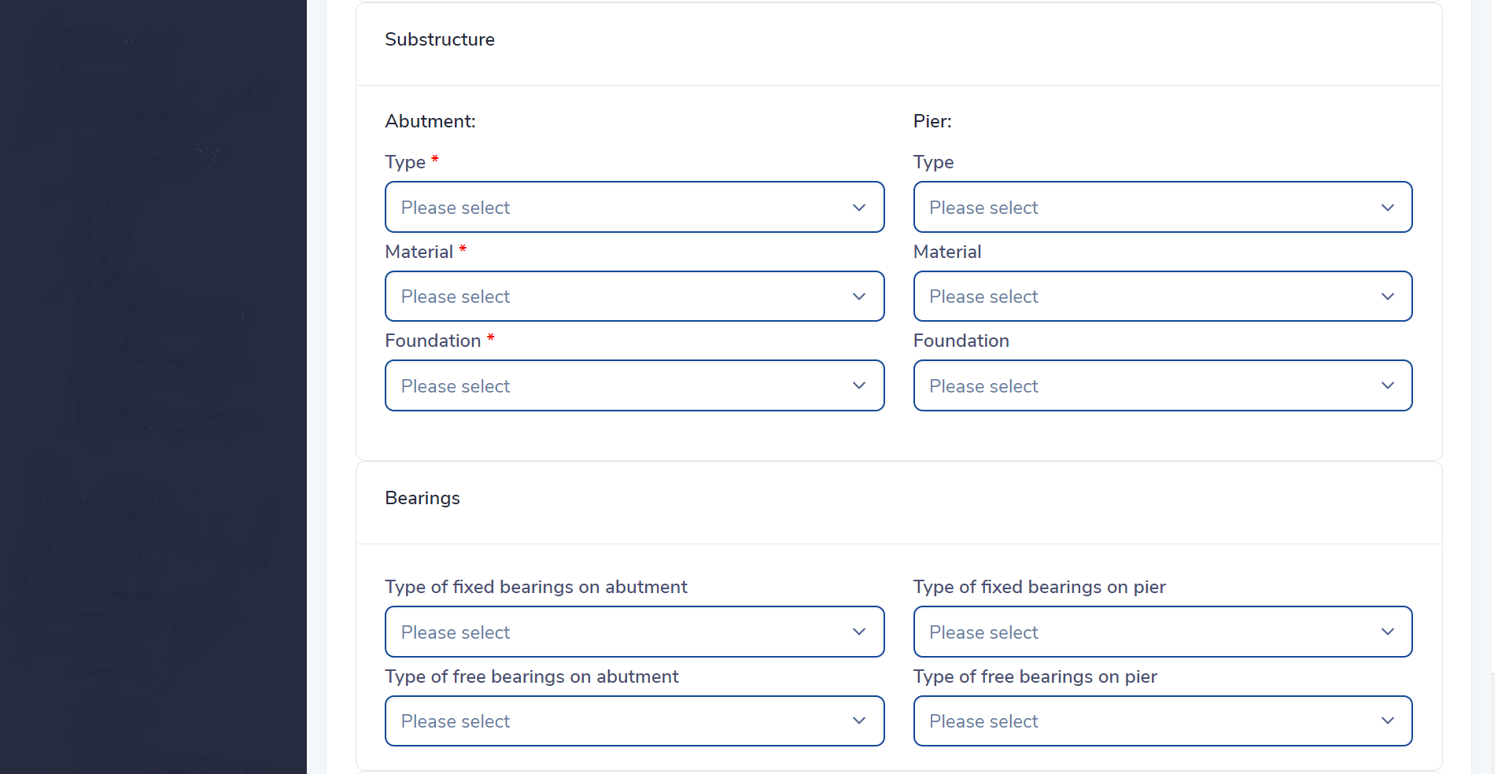
Bridge registration

Slide 6
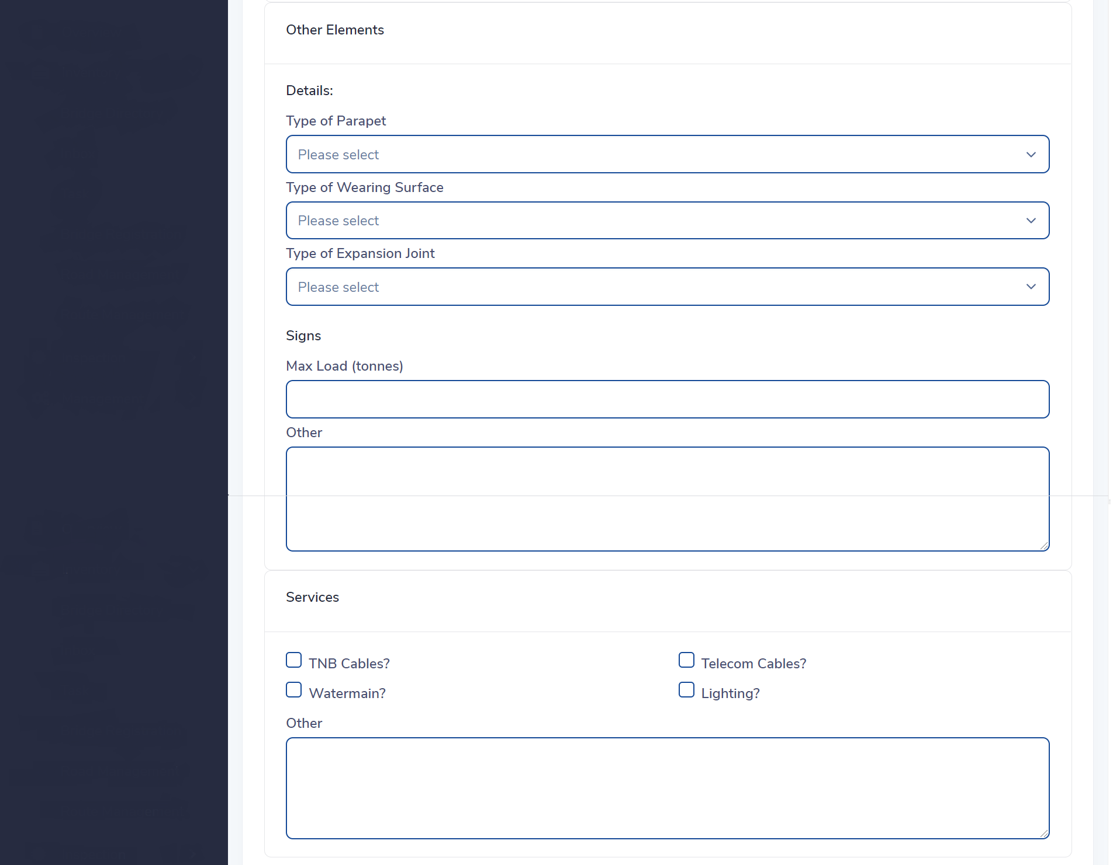
Bridge registration

Slide 7

Bridge registration

Slide 8

Bridge registration

Slide 9

Bridge registration

Slide 10
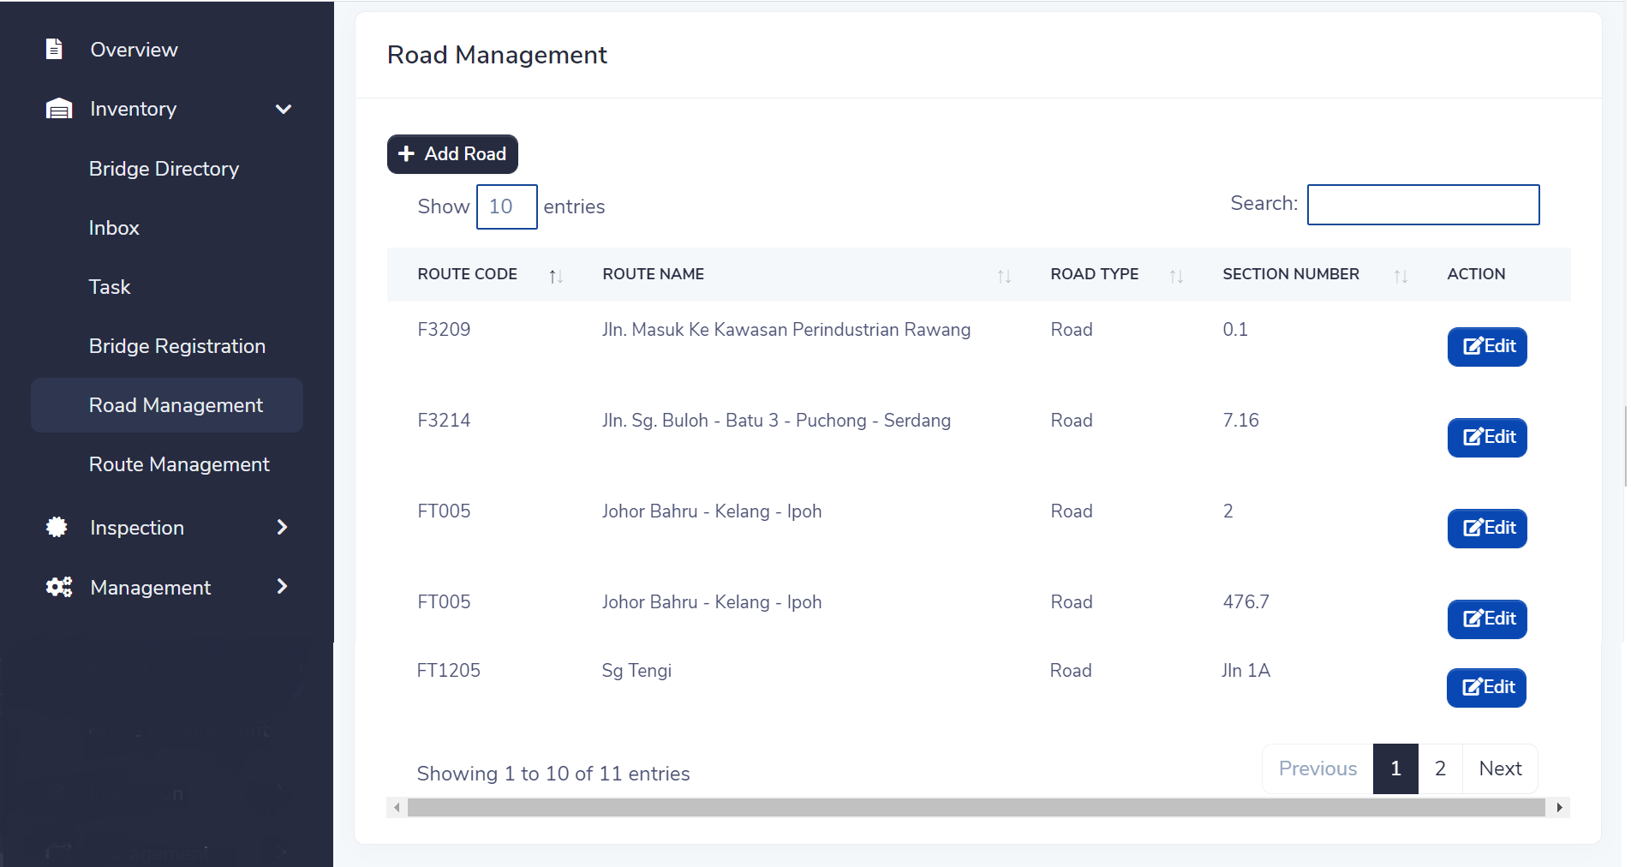
Road Management

Slide 11
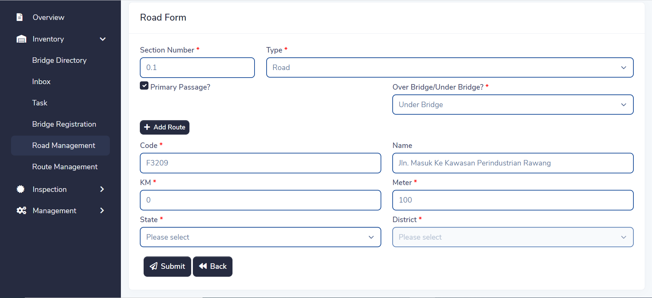
Road Management

Slide 12
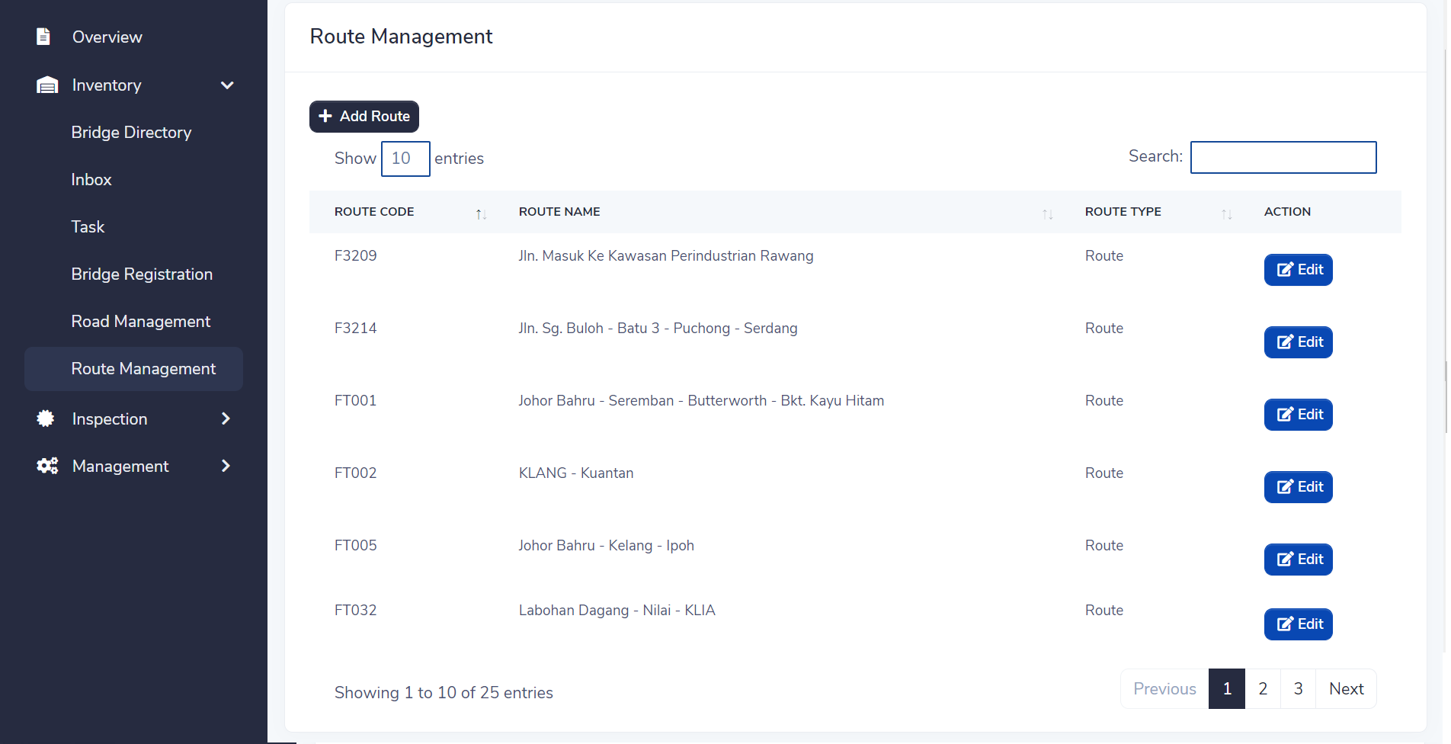
Route Management

Slide 13
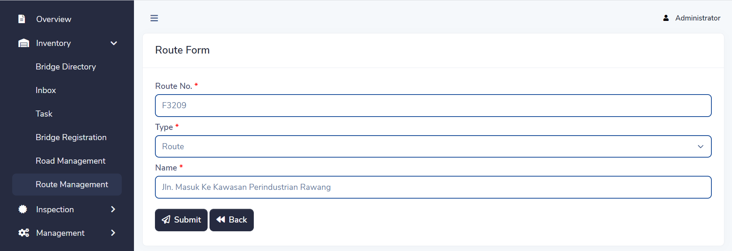
Route Management

Slide 14
Route Management

Slide 15

Bridge listing

Slide 16
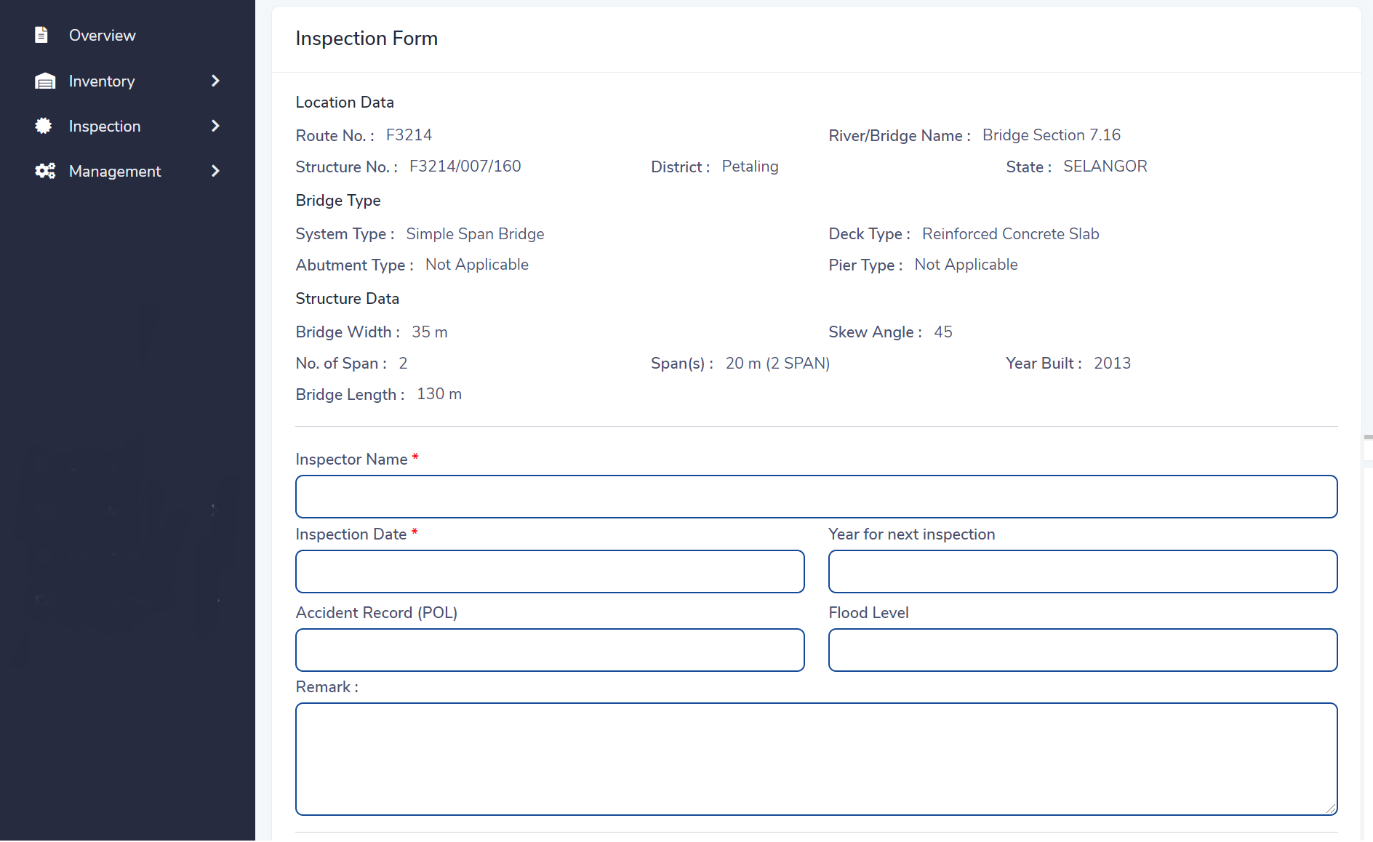
Rating form

Slide 17
Rating form

Slide 18
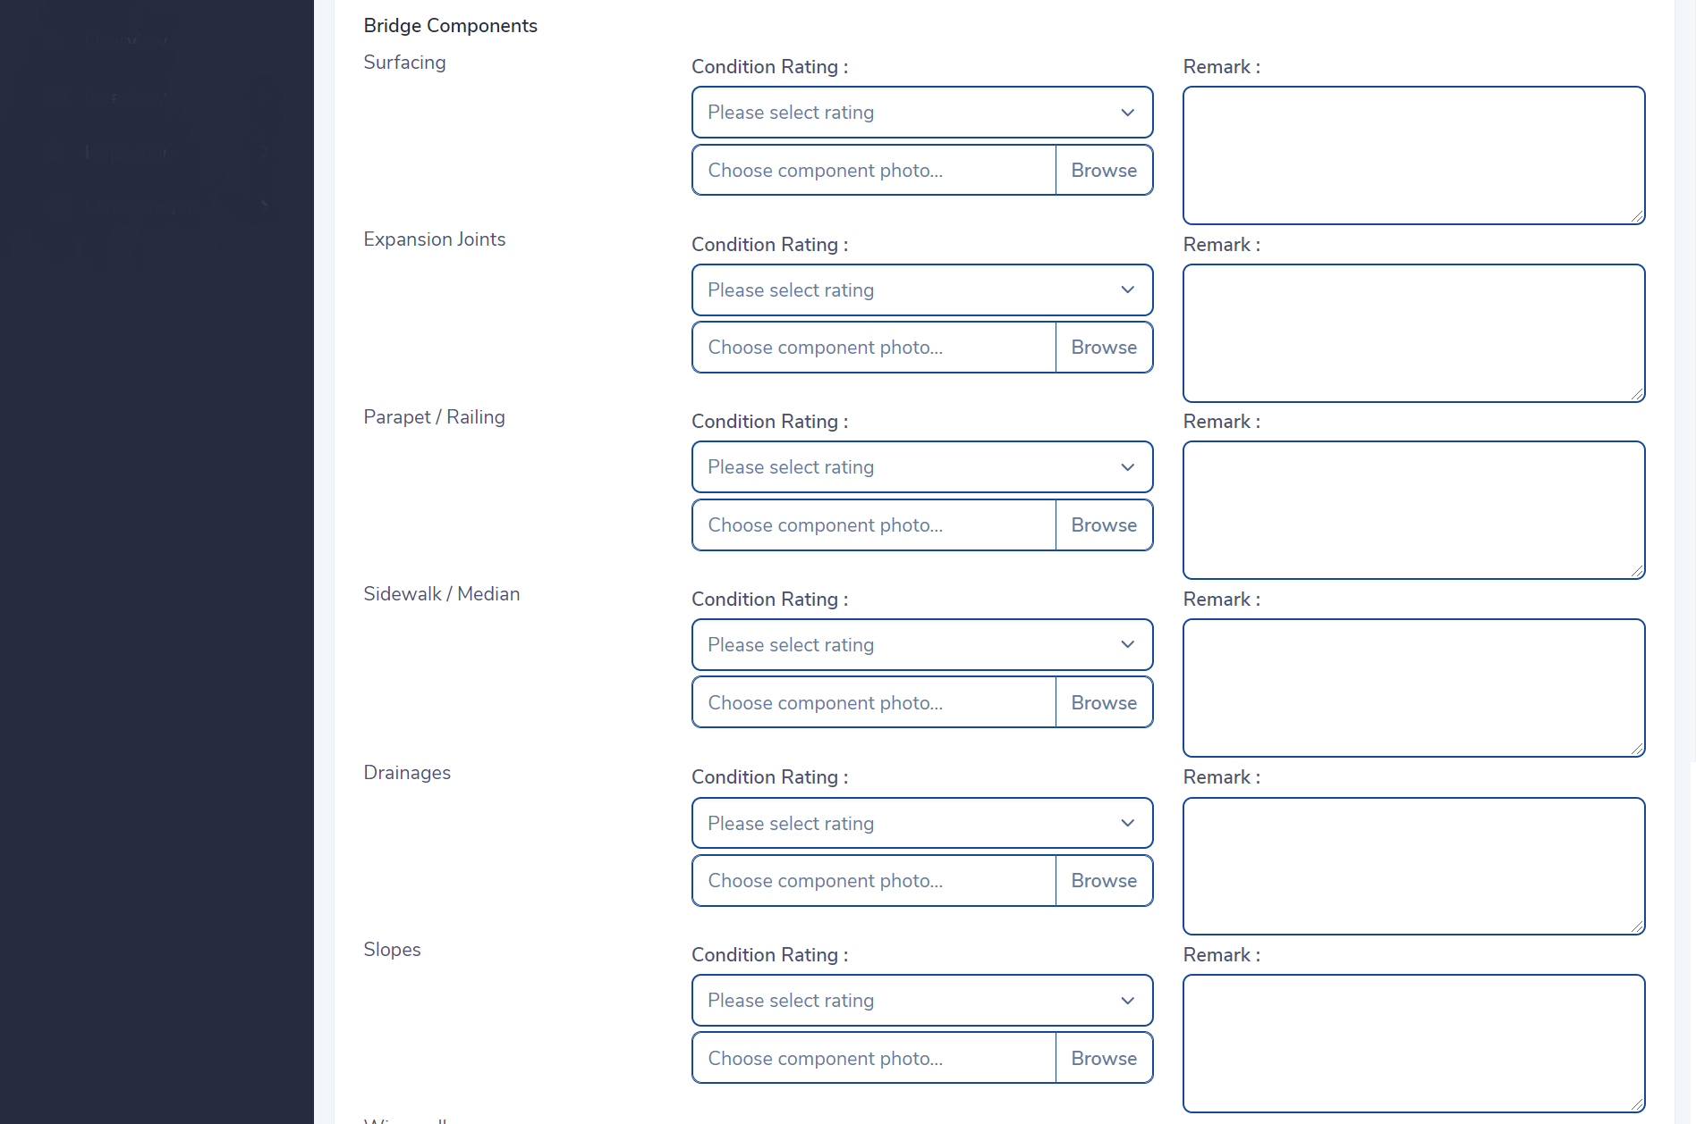
Rating form

Slide 19
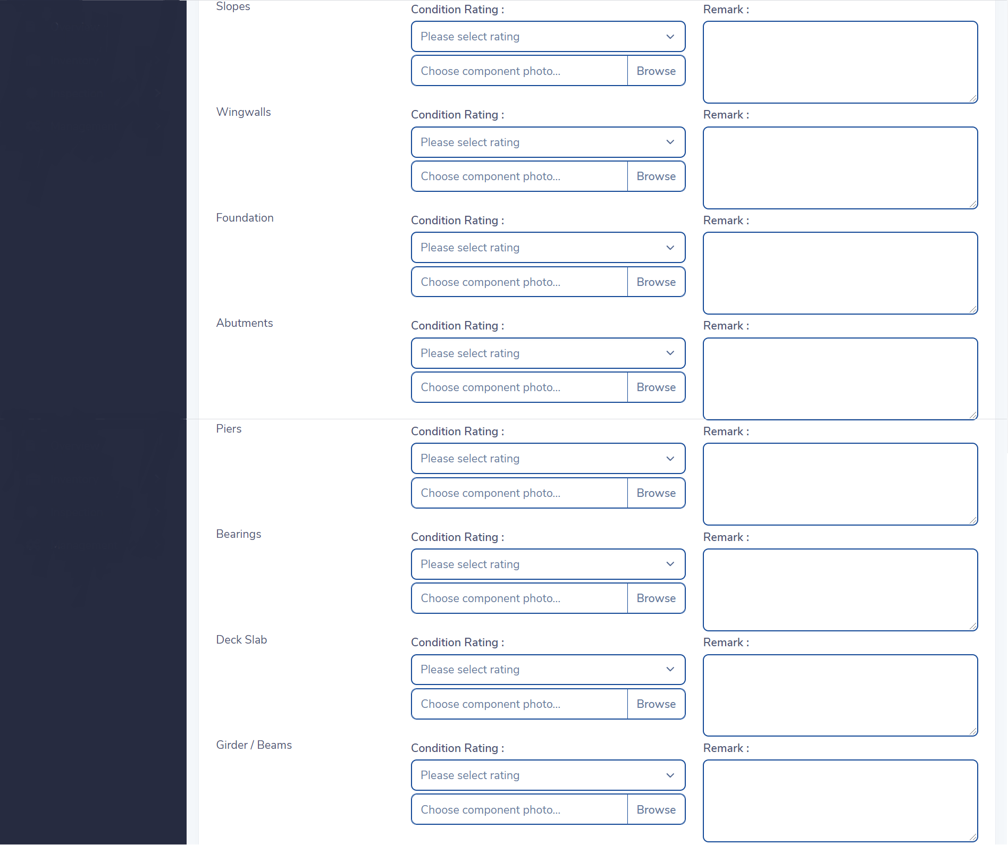
Rating form

Slide 20
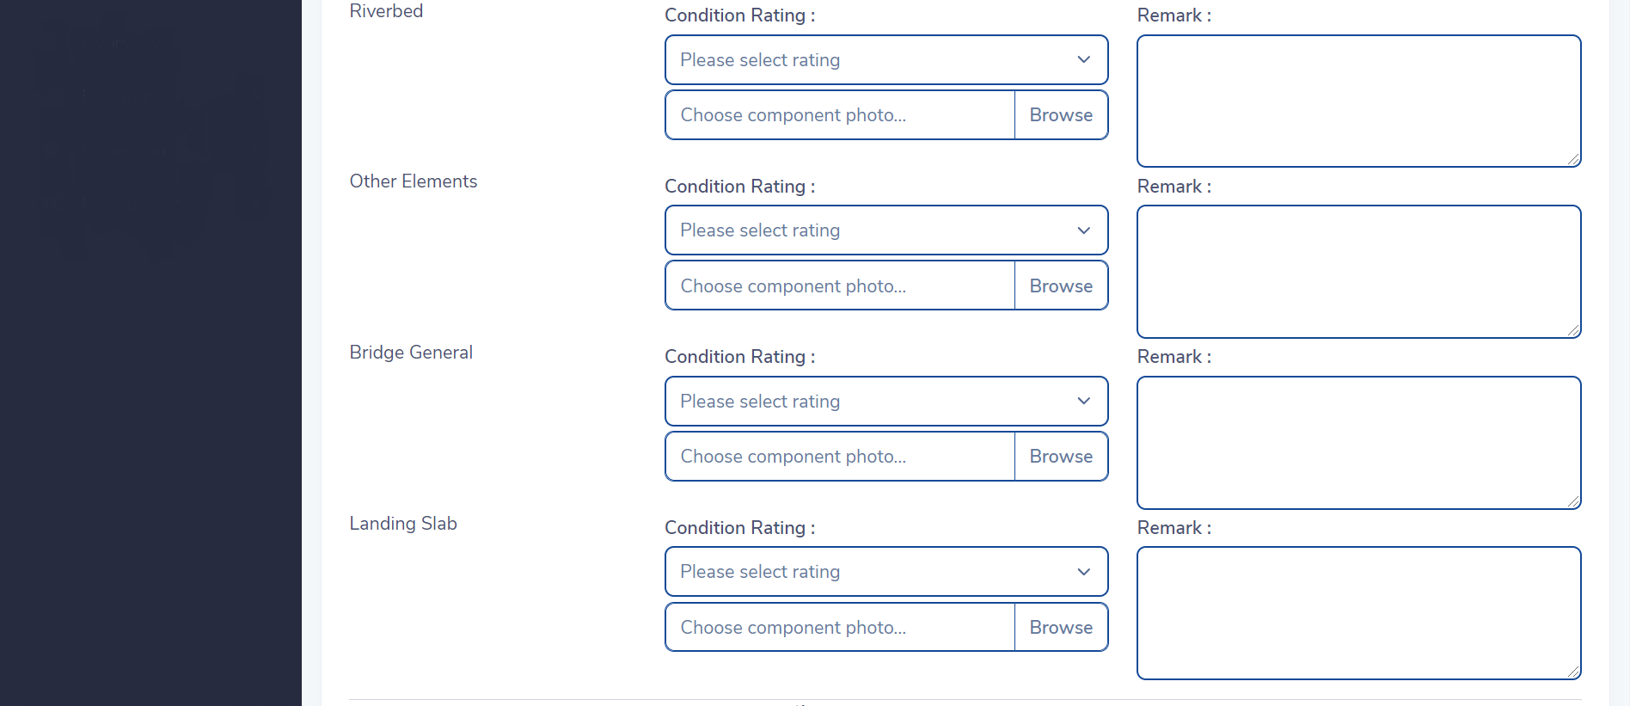
Rating form

Slide 21

Rating form

Slide 22
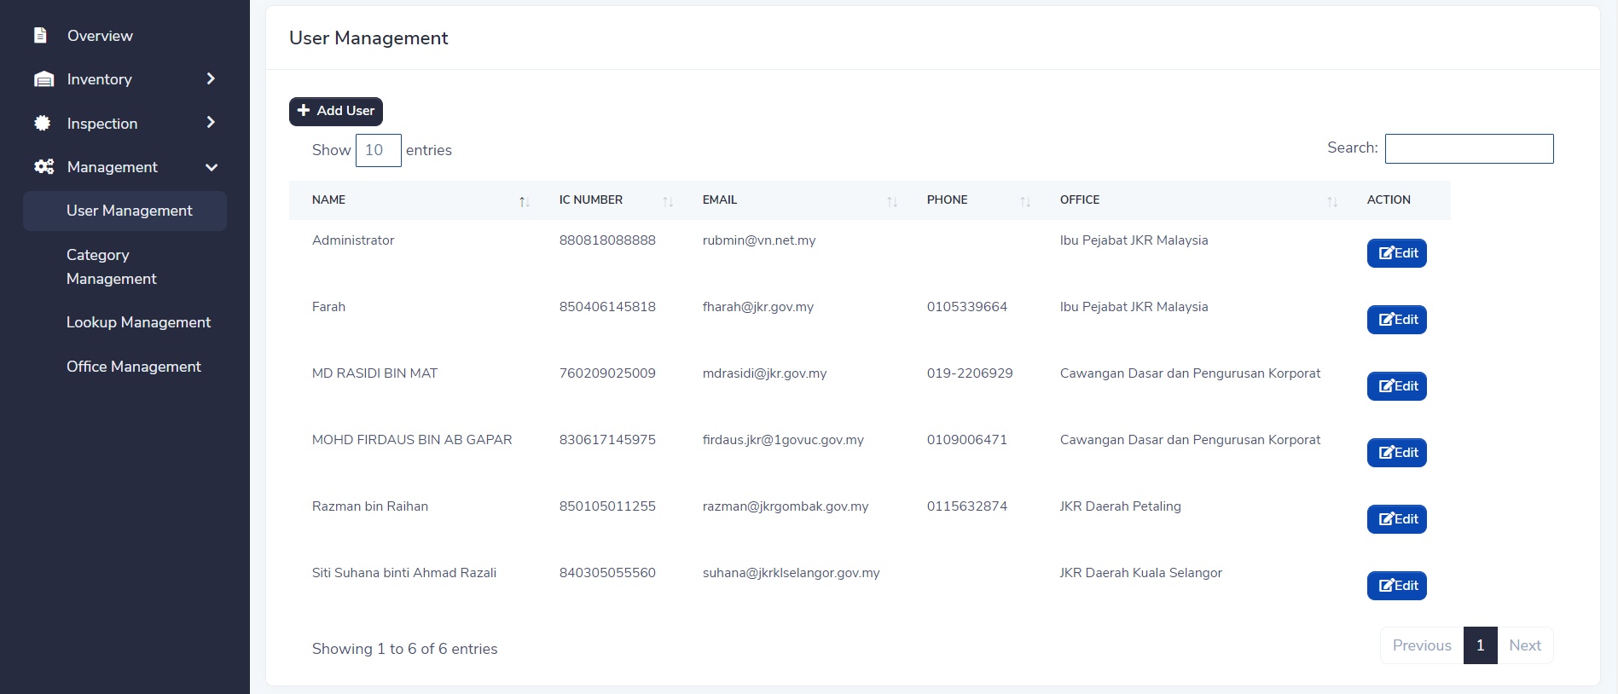
User management

Slide 23
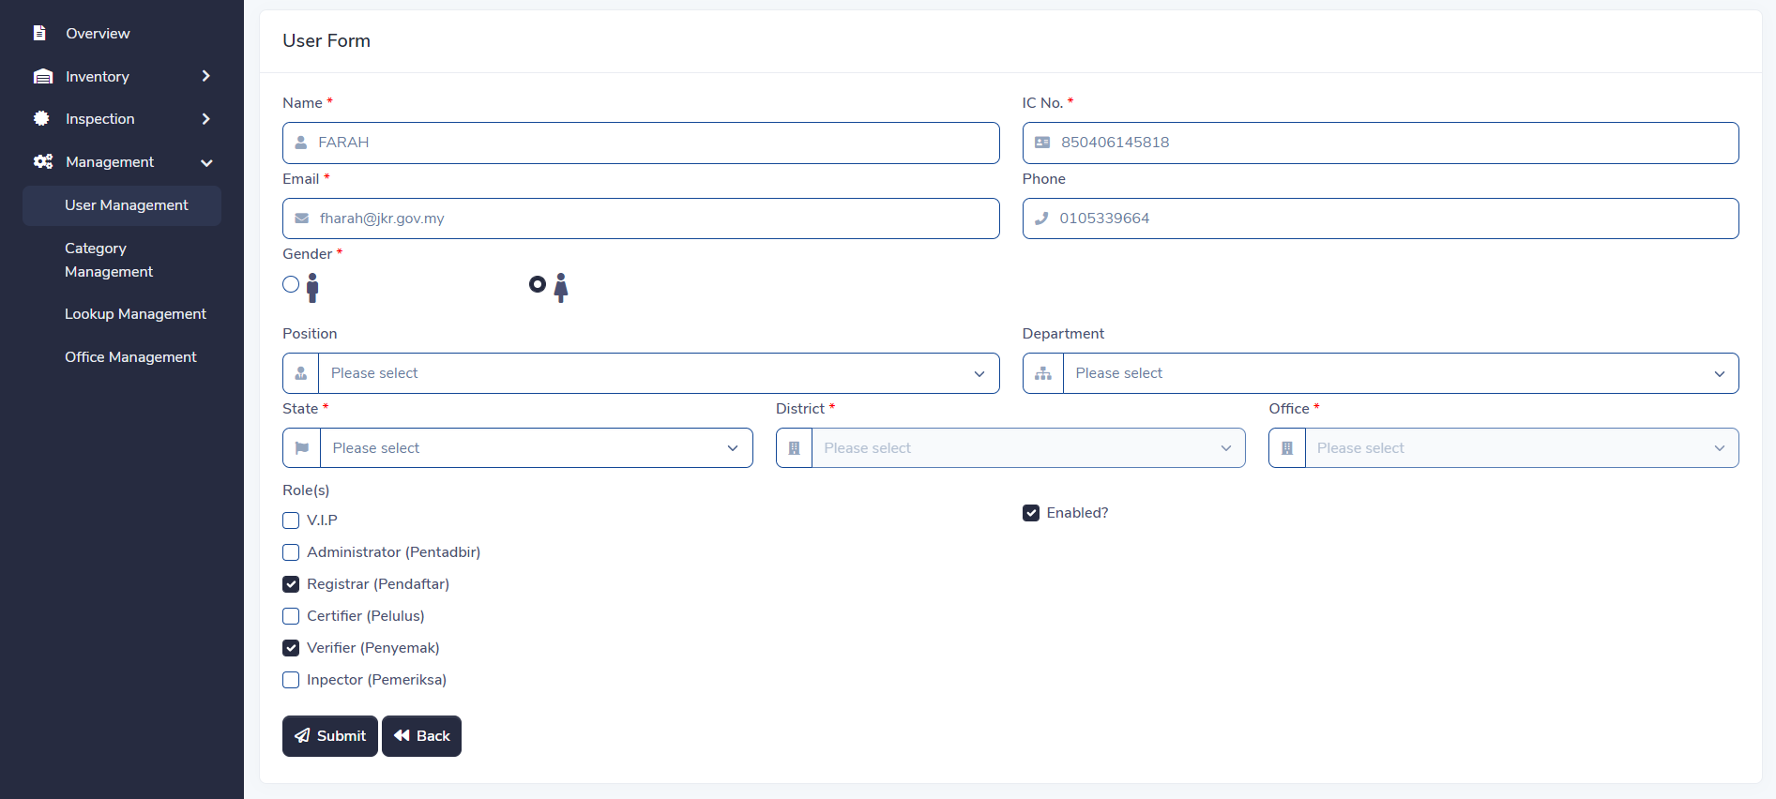
User form

